Slide 1
Cornerstone City Church Peninsula Plus Community Hoo Are Ya
1st February 2026

Slide 2
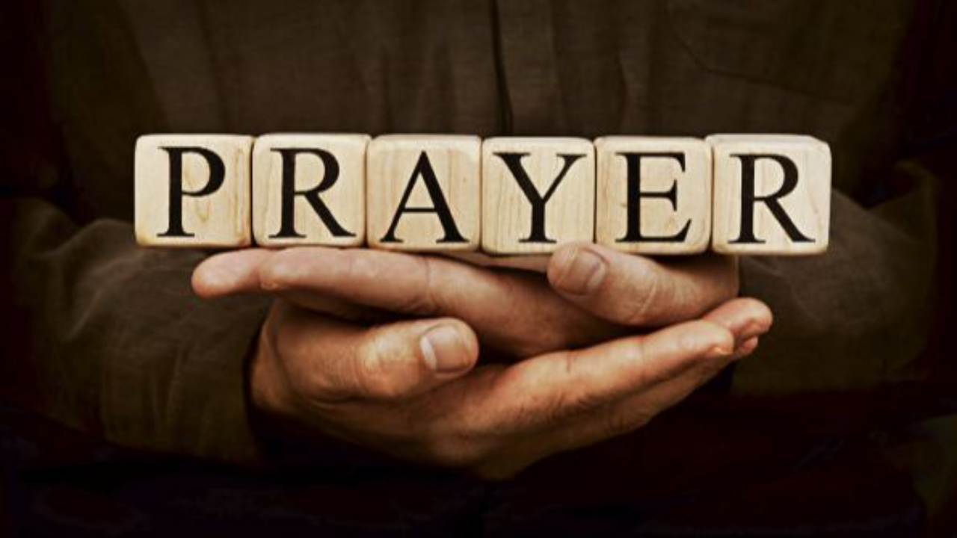

Slide 3
Praise
CCLI Song # 7213077
© Brandon Lake MusicFor Humans PublishingMaverick City PublishingCapitol CMG GenesisCapitol CMG ParagonHousefires SoundsWriter's Roof PublishingMusic by Elevation Worship Publishing
For use solely with the SongSelect® Terms of Use. All rights reserved. www.ccli.com
Note: Reproduction of this sheet music requires a CCLI Music Reproduction Licence. Please report all copies.
CCLI Licence No. 33265

Slide 4
1/12
Let everything that has breath
Praise the Lord
Praise the Lord

Slide 5
2/12
I’ll praise in the valley
Praise on the mountain
I’ll praise when I’m sure
Praise when I’m doubting

Slide 6
3/12
I’ll praise when outnumbered
Praise when surrounded
'Cause praise is the water
My enemies drown in

Slide 7
4/12
As long as I’m breathing
I’ve got a reason to Praise the Lord oh my soul
Praise the Lord oh my soul

Slide 8
5/12
I’ll praise when I feel it
And I’ll praise when I don’t
I’ll praise 'cause I know
You’re still in control

Slide 9
6/12
'Cause my praise is a weapon
It’s more than a sound
My praise is the shout
That brings Jericho down

Slide 10
7/12
As long as I’m breathing
I’ve got a reason to Praise the Lord oh my soul
Praise the Lord oh my soul

Slide 11
8/12
I won’t be quiet
My God is alive
How could I keep it inside
Praise the Lord oh my soul

Slide 12
9/12
I’ll praise 'cause You’re sovereign
Praise 'cause You reign
Praise 'cause You rose and defeated the grave
I’ll praise 'cause You’re faithful
Praise 'cause You’re true
Praise 'cause there’s nobody greater than You

Slide 13
10/12
Praise the Lord oh my soul
Praise the Lord oh my soul
Praise the Lord oh my soul
Praise the Lord oh my soul
I won’t be quiet
My God is alive
How could I keep it inside

Slide 14
1 1/12
I won’t be quiet
My God is alive
How could I keep it inside
I won’t be quiet
My God is alive
How could I keep it inside
Praise the Lord oh my soul

Slide 15
12/12
Let everything that has breath
Praise the Lord
Praise the Lord

Slide 16
I Know Who I Am
CCLI Song # 7115745
Osinachi Kalu Okoro Egbu
© 2013 Integrity Music
For use solely with the SongSelect® Terms of Use. All rights reserved. www.ccli.com
CCLI License # 33265

Slide 17
1/4
We are a chosen generation
Called forth to show His excellence
All I require for life God has given me
I know who I am Repeat

Slide 18
2/4
I know who God says I am what He says I am
Where He says I'm at I know who I am
I know who God says I am what He says I am
Where He says I'm at I know who I am Repeat

Slide 19
3/4
I'm working in power I'm working miracles
I live a life of favour I know who I am
I'm working in power I'm working miracles
I live a life of favour I know who I am Repeat

Slide 20
4/4
Take a look at me I'm a wonder
It doesn't matter what you see now
Can you see His glory I know who I am

Slide 22
Worthy
CCLI Song # 7111931
Chris Brown | Mack Brock | Steven Furtick
© Music by Elevation Worship Publishing (Admin. by Essential Music Publishing LLC)
For use solely with the SongSelect® Terms of Use. All rights reserved. www.ccli.com
CCLI Licence No. 33265

Slide 23
1/6
It was my cross You bore
So I could live in the freedom You died for
And now my life is Yours
And I will sing of Your goodness forevermore

Slide 24
2/6
Worthy is Your name, Jesus
You deserve the praise
Worthy is Your name
Worthy is Your name, Jesus
You deserve the praise
Worthy is Your name

Slide 25
3/6
And now my shame is gone
I stand amazed in Your love undeniable
Your grace goes on and on
And I will sing of Your goodness forevermore

Slide 26
4/6
Worthy is Your name, Jesus
You deserve the praise
Worthy is Your name
Worthy is Your name, Jesus
You deserve the praise
Worthy is Your name (REPEAT)

Slide 27
5/6
Be exalted now in the heavens
As Your glory fills this place
You alone deserve our praise
You're the name above all names (REPEAT)

Slide 28
6/6
Worthy is Your name, Jesus
You deserve the praise
Worthy is Your name
Worthy is Your name, Jesus
You deserve the praise
Worthy is Your name

Slide 29
1/1
My chains are gone I've been set free
My God my Savior has ransomed me
And like a flood His mercy rains
Unending love amazing grace

Slide 31
What A Beautiful Name
CCLI Song # 7068424
Ben Fielding | Brooke Ligertwood
© 2016 Hillsong Music Publishing Australia (Admin. by Hillsong Music Publishing UK)
For use solely with the SongSelect® Terms of Use. All rights reserved. www.ccli.com
CCLI Licence No. 33265

Slide 32
1/7
You were the Word at the beginning One with God the Lord Most High Your hidden glory in creation Now revealed in You our Christ

Slide 33
2/7
What a beautiful Name it is What a beautiful Name it is The Name of Jesus Christ my King What a beautiful Name it is Nothing compares to this What a beautiful Name it is The Name of Jesus

Slide 34
3/7
You didn't want heaven without us So Jesus You brought heaven down My sin was great Your love was greater What could separate us now

Slide 35
4/7
What a wonderful Name it is What a wonderful Name it is The Name of Jesus Christ my King What a wonderful Name it is Nothing compares to this What a wonderful Name it is The Name of Jesus What a wonderful Name it is The Name of Jesus

Slide 36
5/7
Death could not hold You The veil tore before You You silence the boast of sin and grave The heavens are roaring The praise of Your glory For You are raised to life again

Slide 37
6/7
You have no rival You have no equal Now and forever God You reign Yours is the kingdom Yours is the glory Yours is the Name above all names

Slide 38
7/7
What a powerful Name it is What a powerful Name it is The Name of Jesus Christ my King What a powerful Name it is Nothing can stand against What a powerful Name it is The Name of Jesus

Slide 39


Slide 40
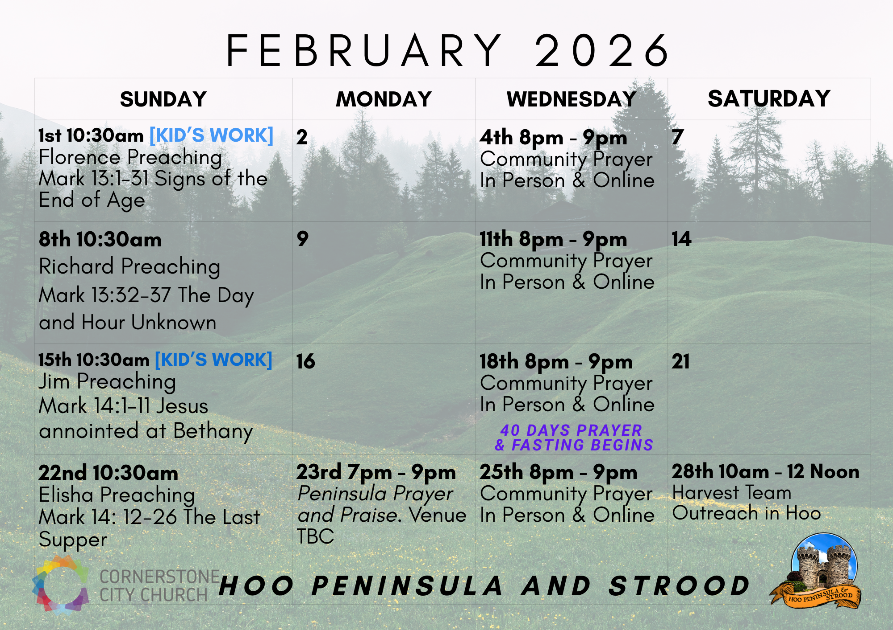

Slide 41
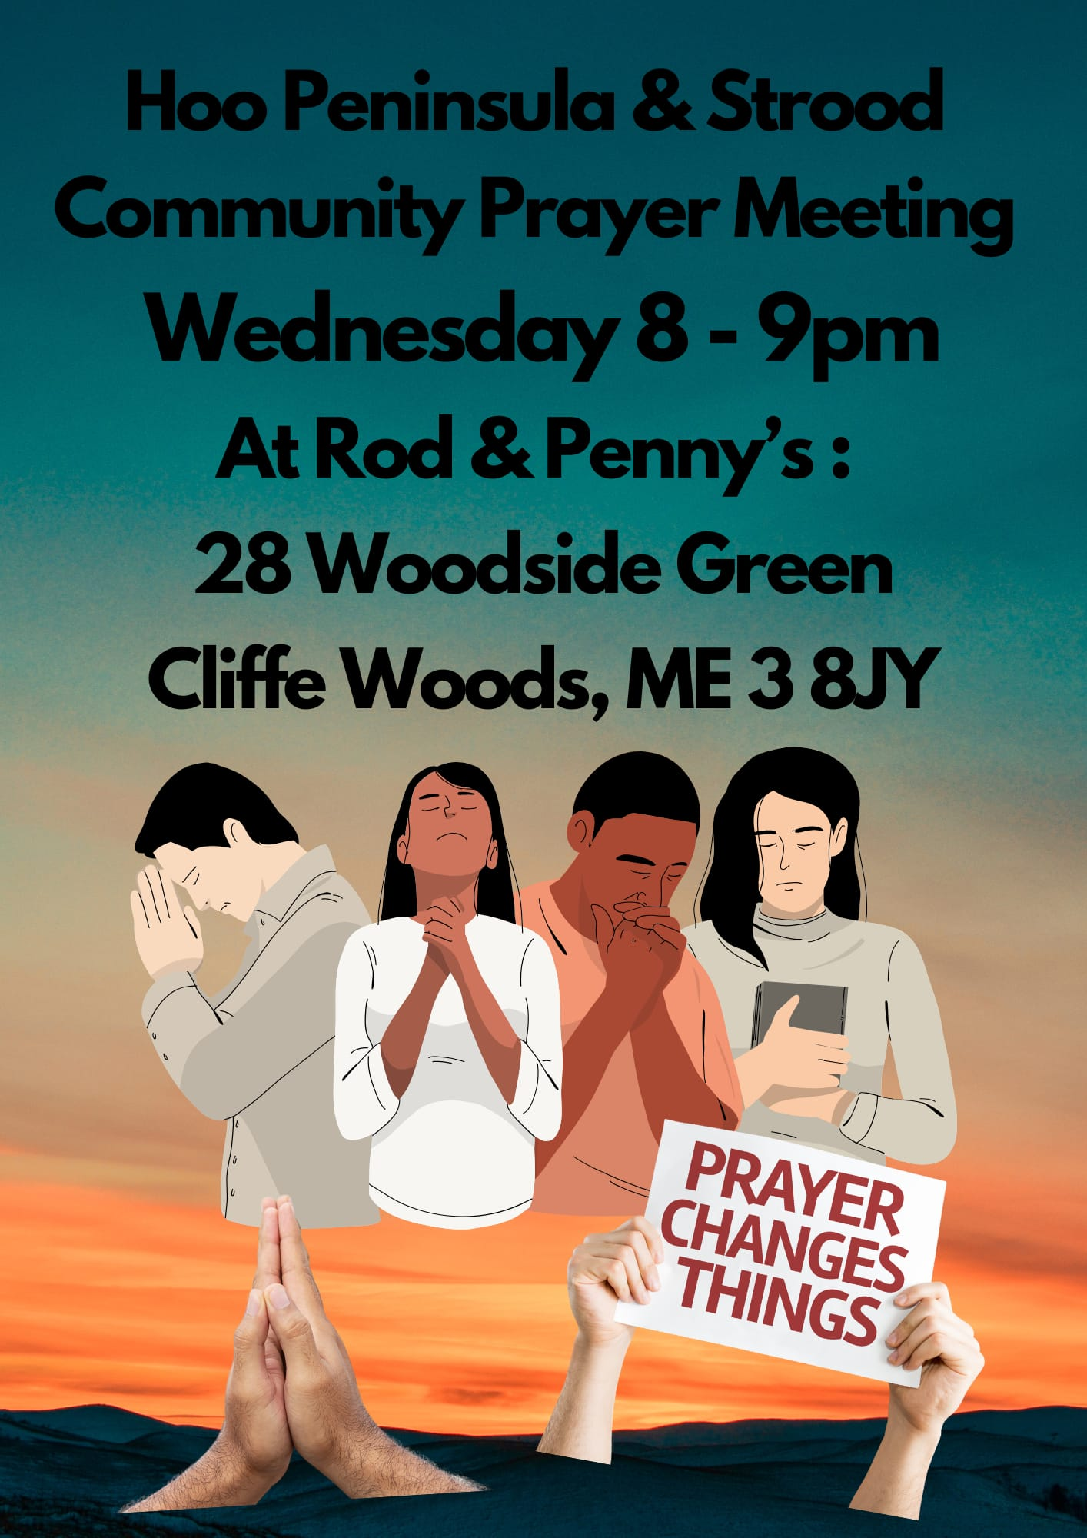

Slide 42
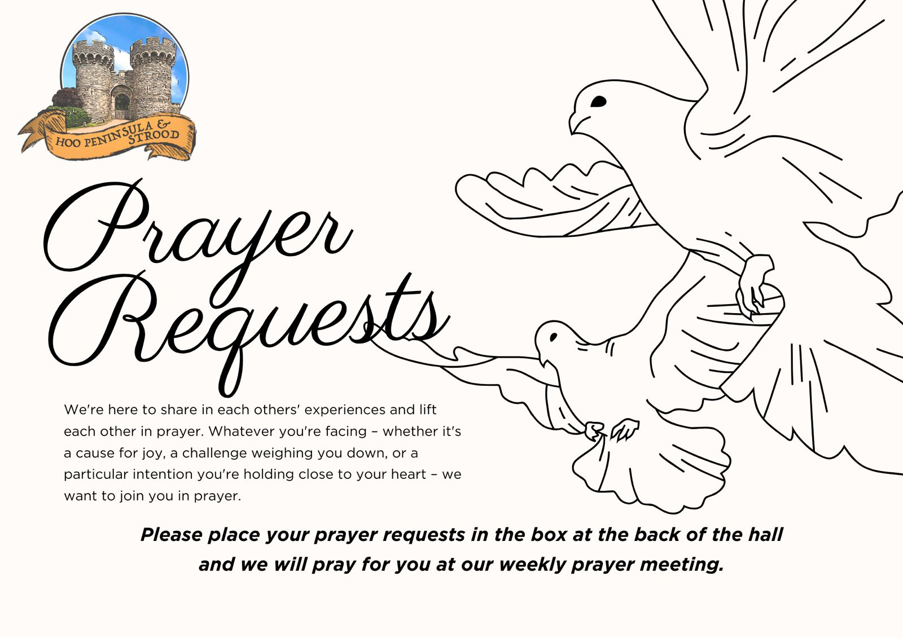

Slide 43


Slide 44
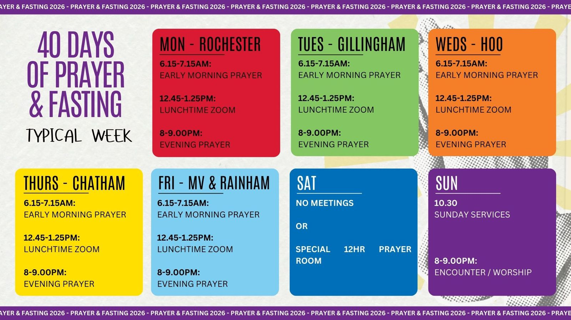

Slide 45


Slide 46
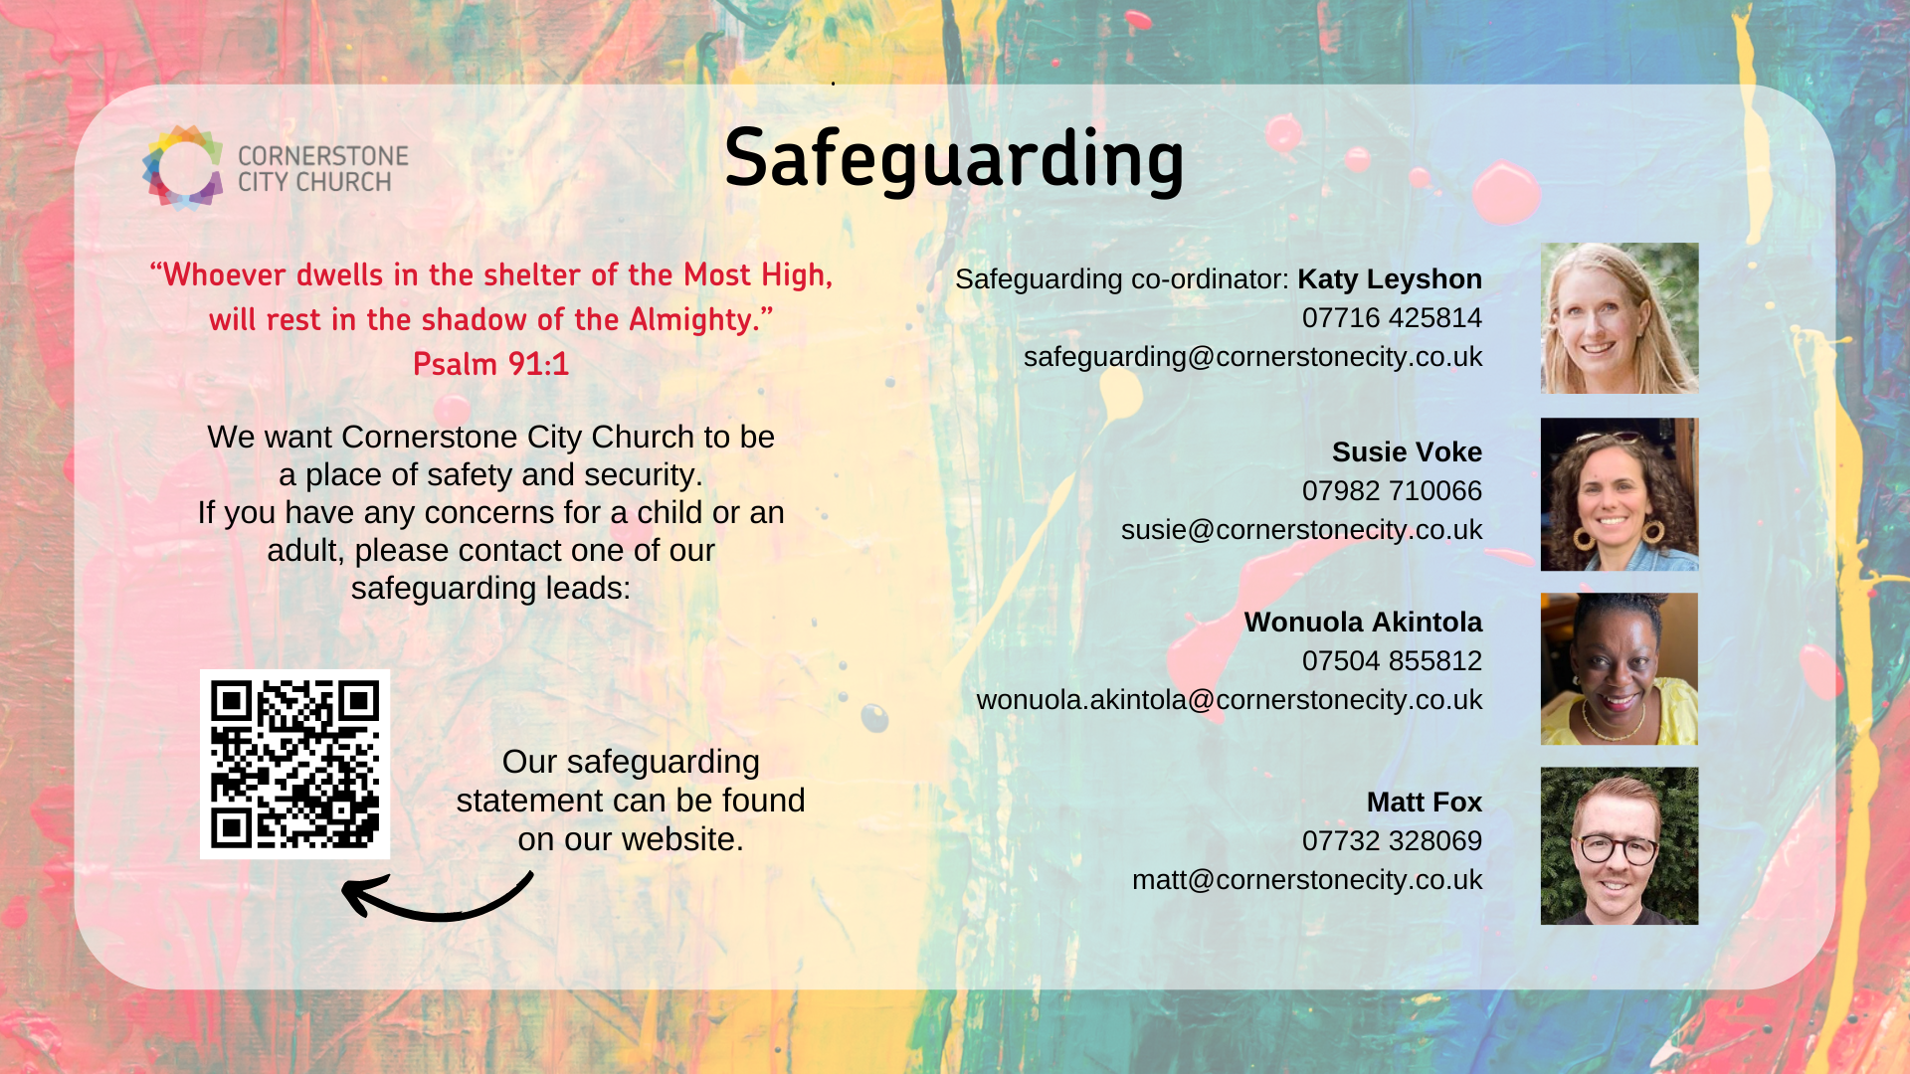

Slide 47


Slide 48


Slide 49
2 Corinthians 14 May the grace of the Lord Jesus Christ, and the love of God, and the fellowship of the Holy Spirit be with us all. And….
Surely goodness and mercy shall follow us all the days of our lives, and we shall dwell in the house of the Lord forever.

